Slide 1
Adaptive phase-field modeling of heterogeneous materials
Treball de final de grau
Roger Llorenç i Vilanova
Director: Antonio Rodriguez-Ferran
Departament d’Enginyeria Civil i Ambiental

Slide 2
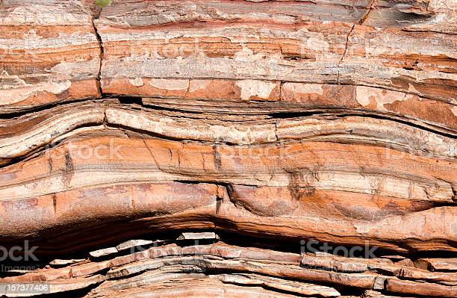
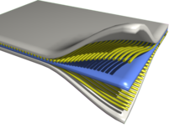

Fracture
Understanding cracks: avoid, stop, mitigate, promote and control
Homogeneous / heterogeneous materials
Failure / Success

Slide 3
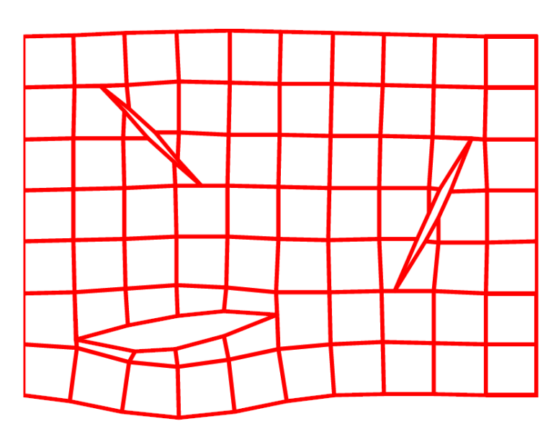
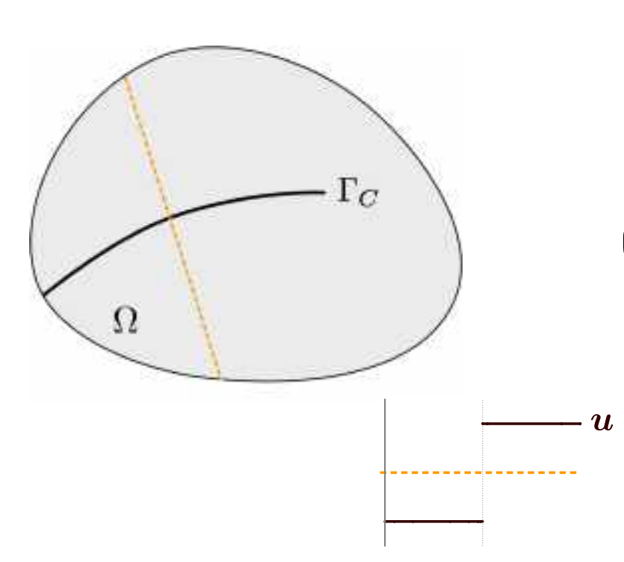
Computational fracture mechanics
Discontinuous models: sharp cracks
Discontinuous displacement field
Might be less efficient due to remeshing

Slide 4
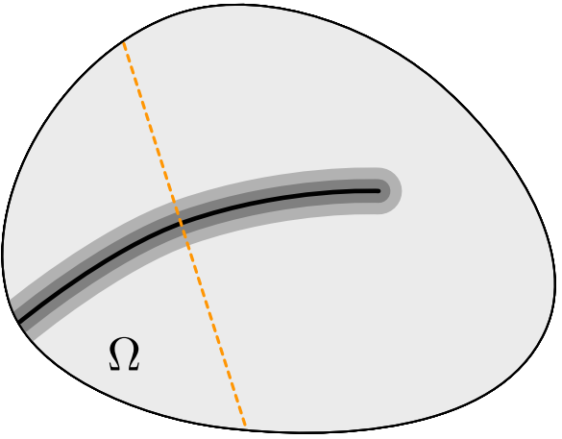
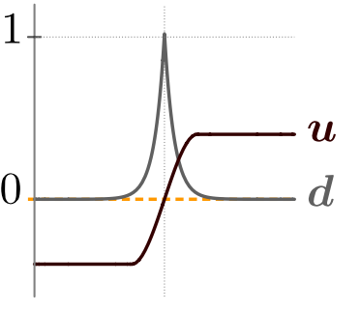
Computational fracture mechanics
Continuous models – phase field: diffuse cracks
Continuous displacement field
Loss of stiffness represented by damage variable d
d = 0 for intact material; d = 1 for fully broken material
Length-scale parameter l
History variable H

Slide 5
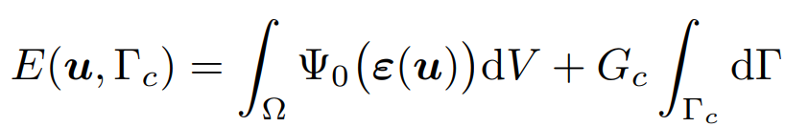
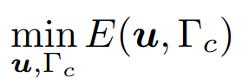
Energy minimization principle
Continuous models – phase field:
Based on an energy minimization principle
Francfort and Marigo (1998)

Slide 6
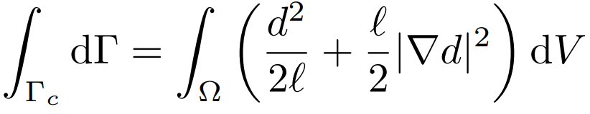
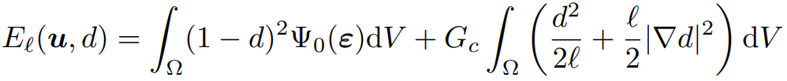
Regularization of the fracture energy
Continuous models – phase field:
Regularization of the fracture energy – Tractable numerically!
Bourdin et al., (2000)

Slide 7
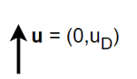
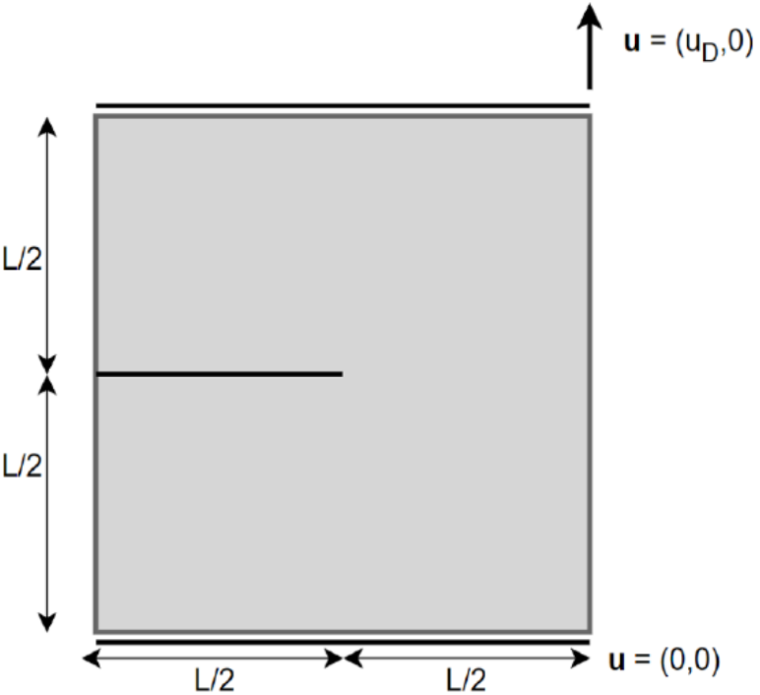
Continuous displacement field
Two-dimensional tension test

Slide 8
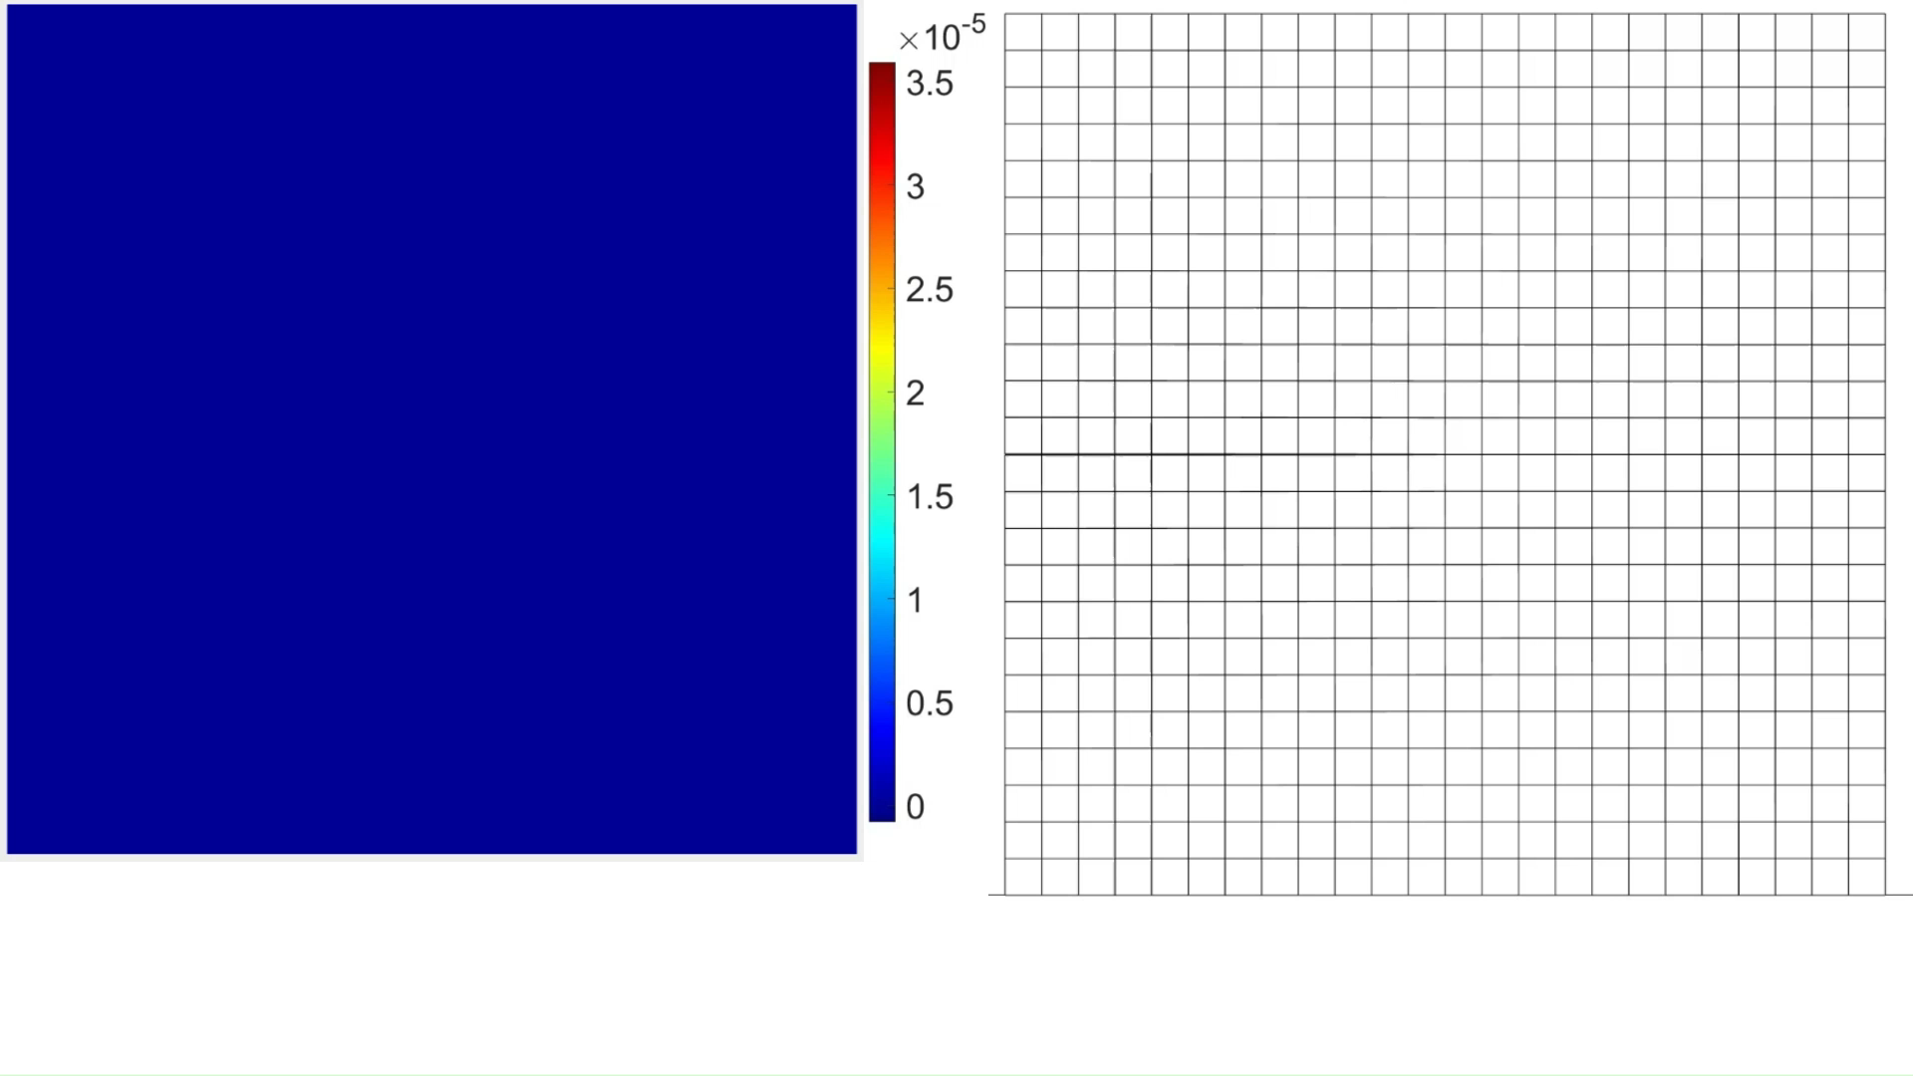
Continuous displacement field
Damage field and deformed mesh
Deformation scale factor = 10

Slide 9
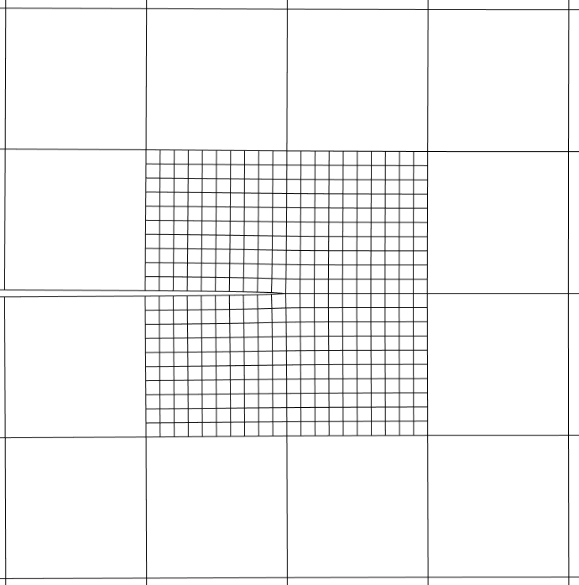
Adaptive refinement
Fine meshes required along the crack → High computational cost
Refinement value d > d* = 0.2 → Automatic refinement
Refinement factor m = 10
m
m
m
m

Slide 10
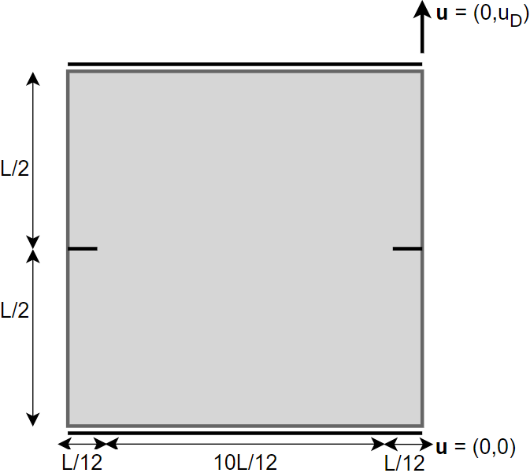
Adaptive refinement example

Slide 11
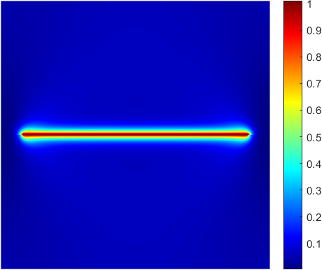
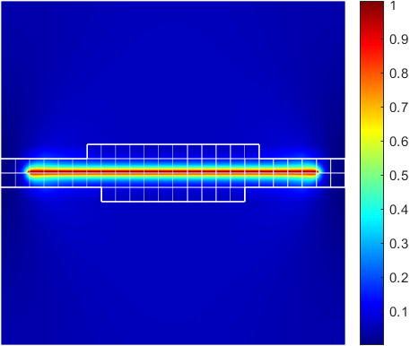
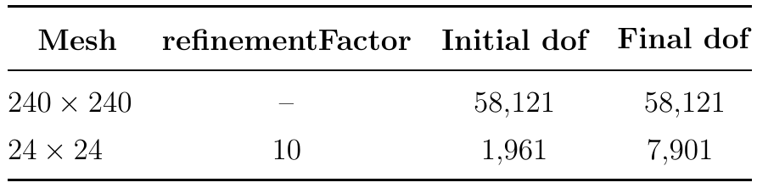
Adaptive refinement example

Slide 12
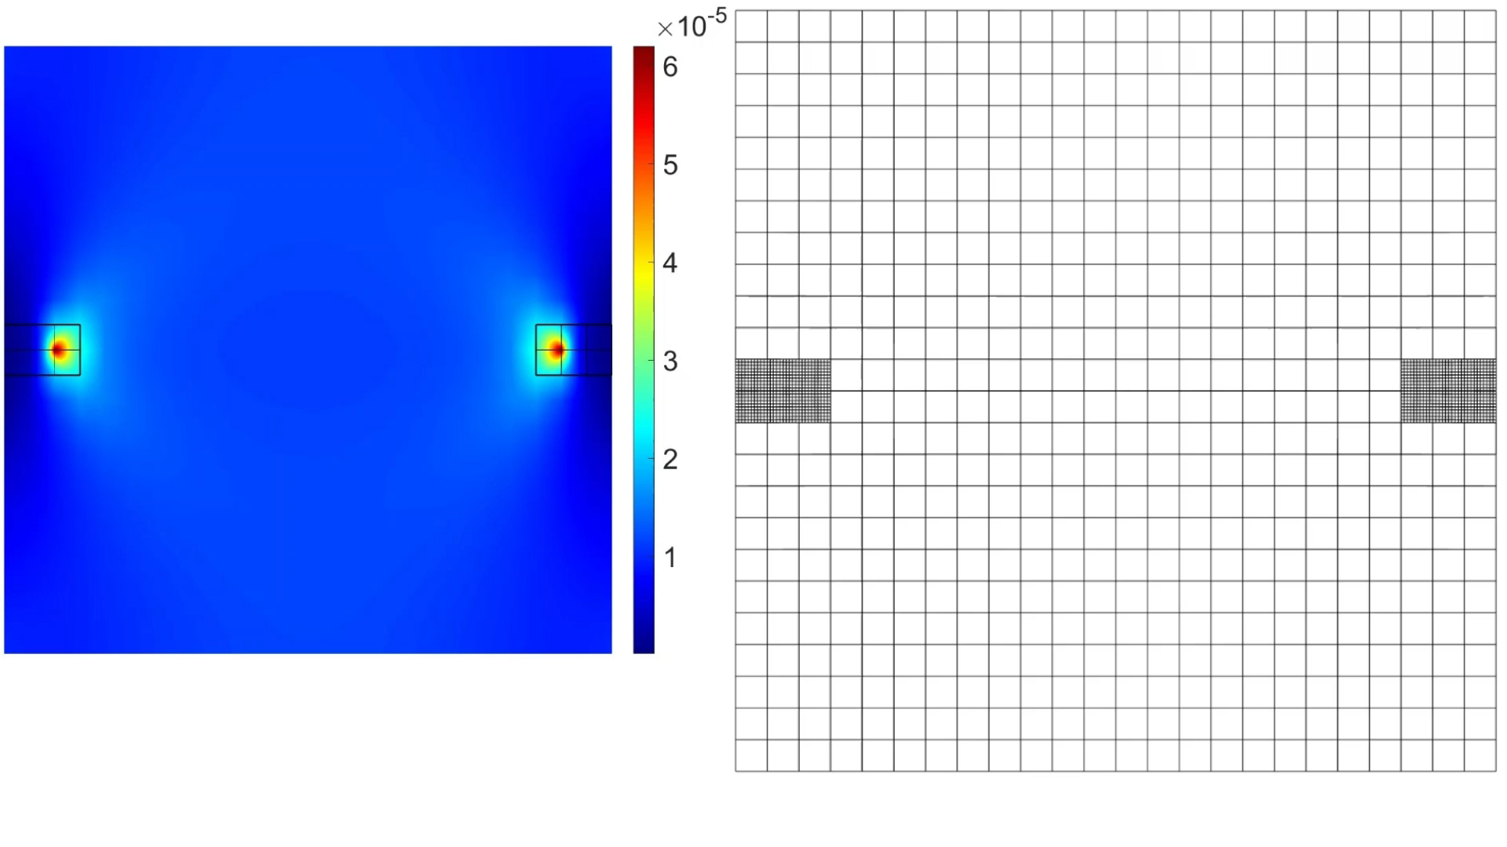
Adaptive refinement example
Deformation scale factor = 10

Slide 13
Goals
Acquire familiarity with the existing adaptive phase-field model for homogeneous materials (Muixí, 2020)
Extend the phase-field model and the Matlab code to heterogeneous materials
Design and carry out computational tests of fracture in heterogeneous materials
Analyze the results and gain insight of fracture in heterogeneous materials

Slide 14

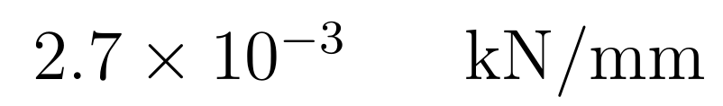

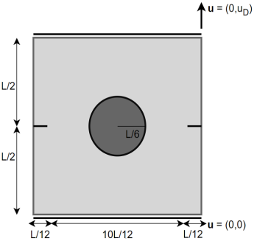
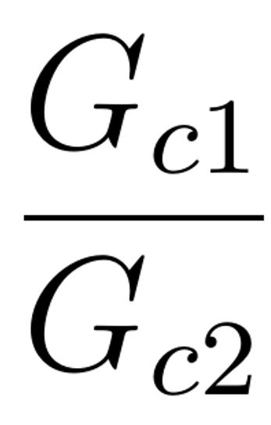

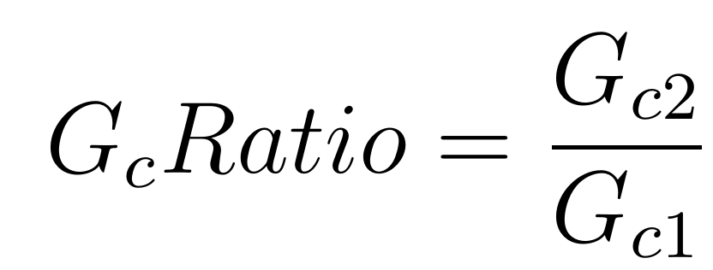
Arrest, deflection and penetration of the crack
Fracture toughness
Young modulus E = 210 GPa
Poisson’s ratio ν = 0

Slide 15
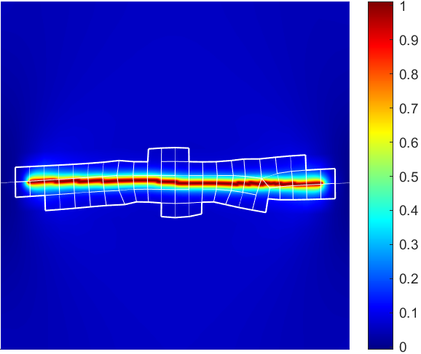
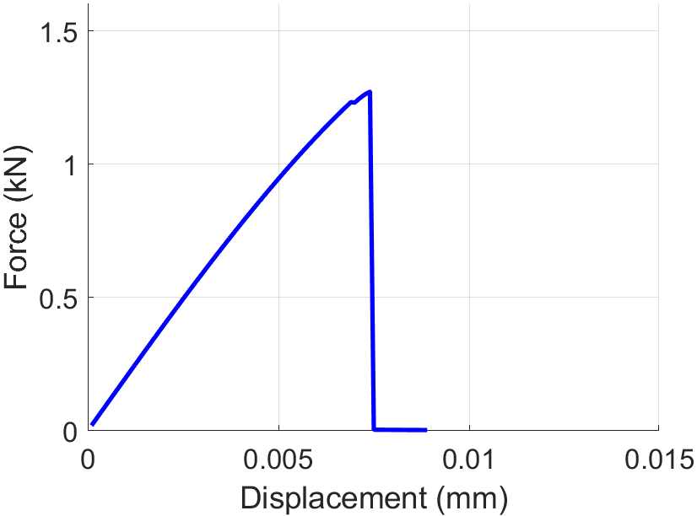
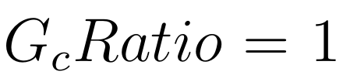
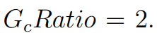
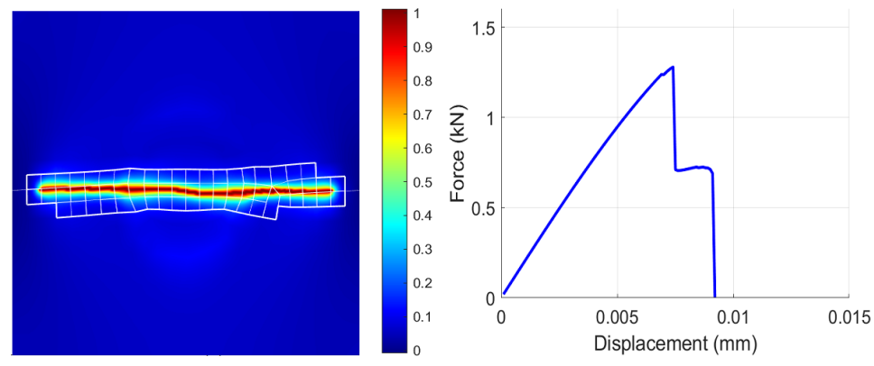
Arrest, deflection and penetration of the crack

Slide 16
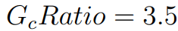
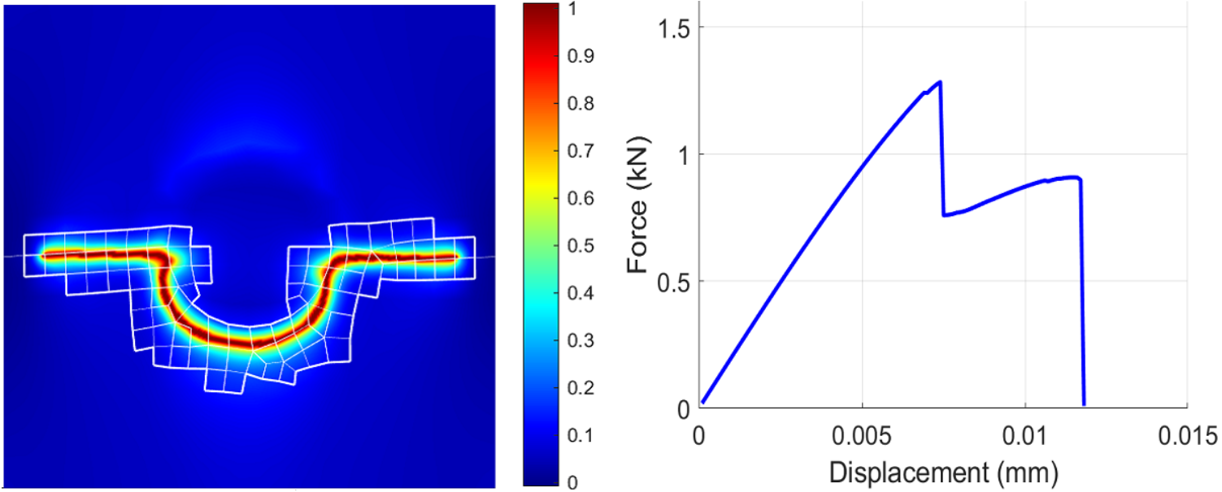
Arrest, deflection and penetration of the crack

Slide 17
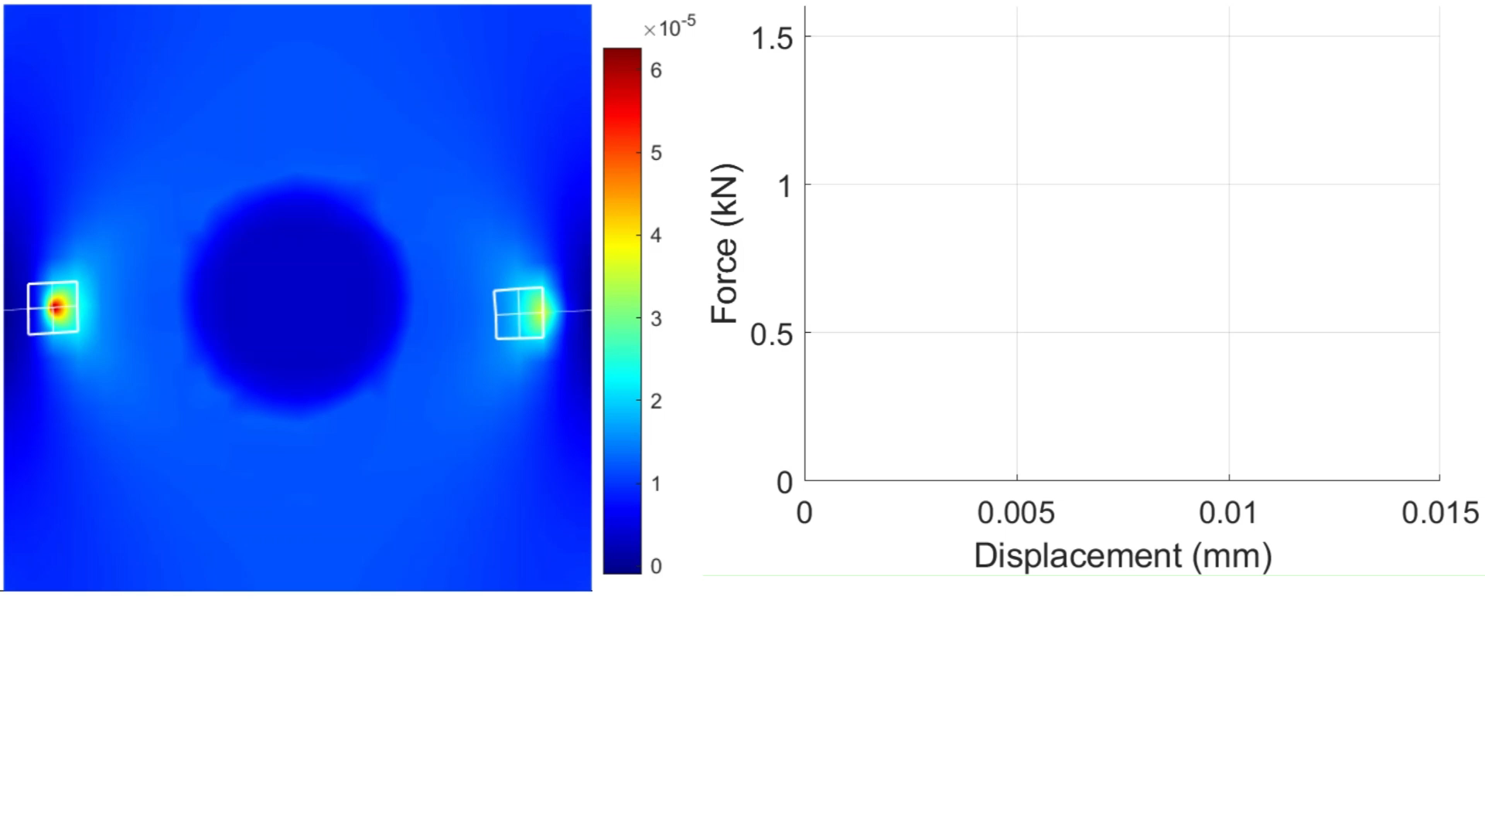
Arrest, deflection and penetration of the crack

Slide 18
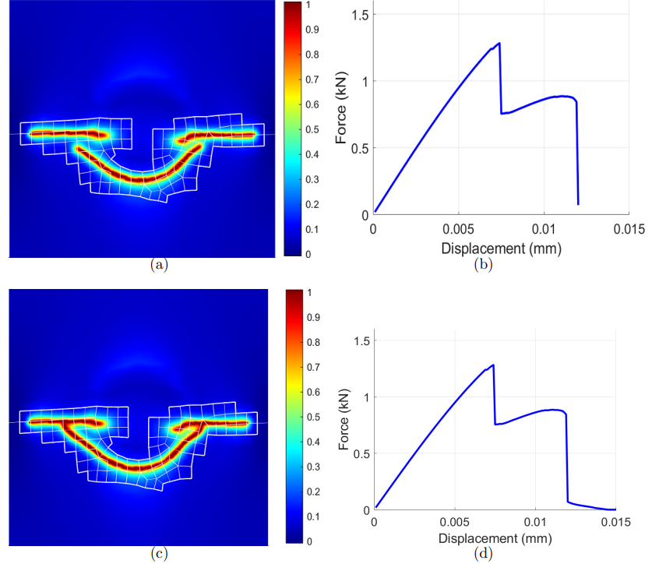
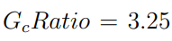
Arrest, deflection and penetration of the crack

Slide 19
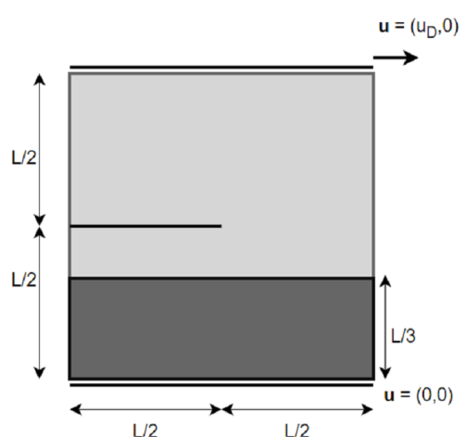
Arrest, deflection and penetration of the crack
Shear test

Slide 20
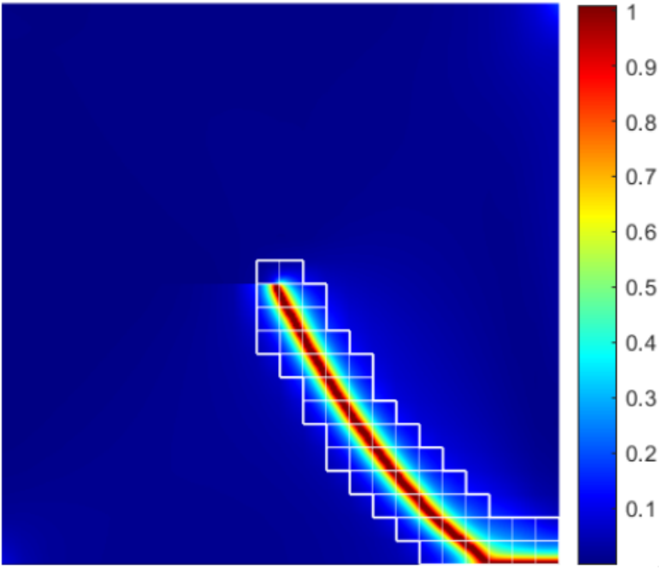
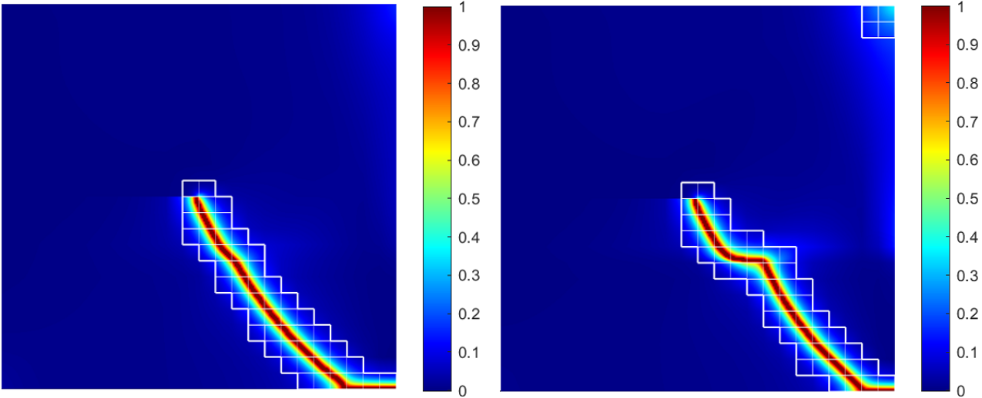
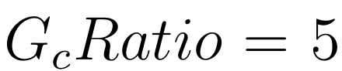
Arrest, deflection and penetration of the crack

Slide 21
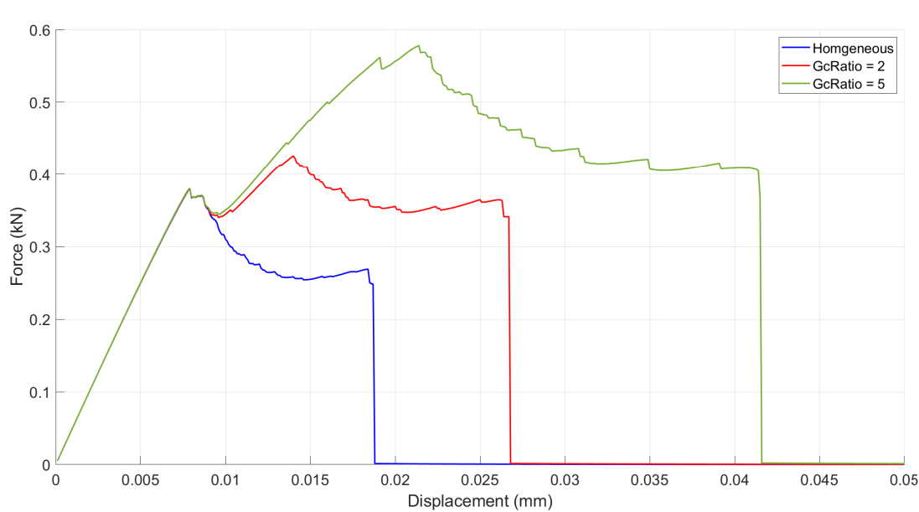
Arrest, deflection and penetration of the crack

Slide 22
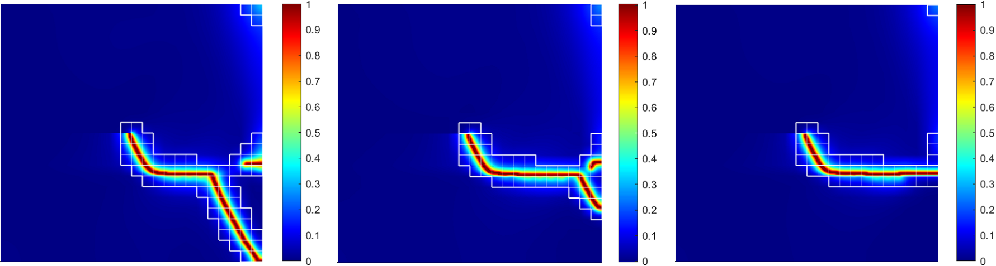
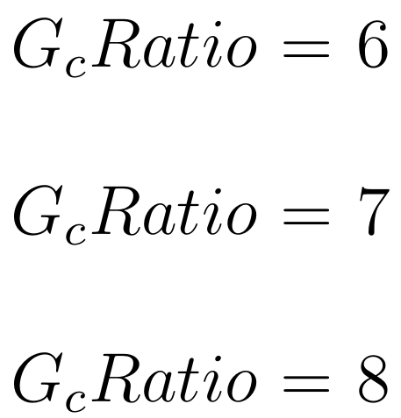
Arrest, deflection and penetration of the crack

Slide 23
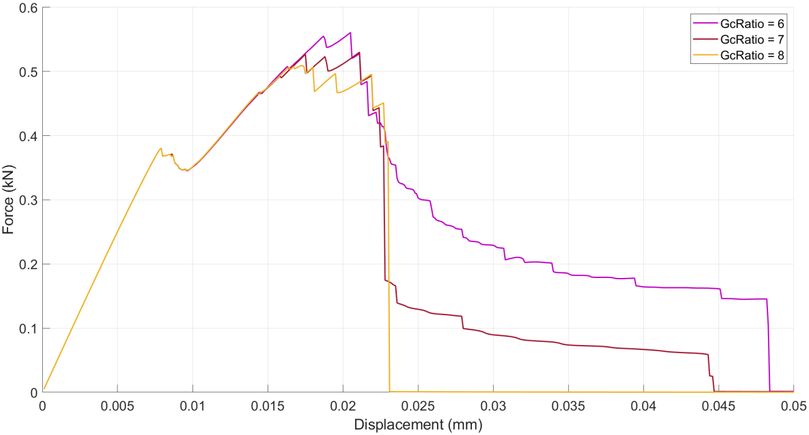
Arrest, deflection and penetration of the crack

Slide 24
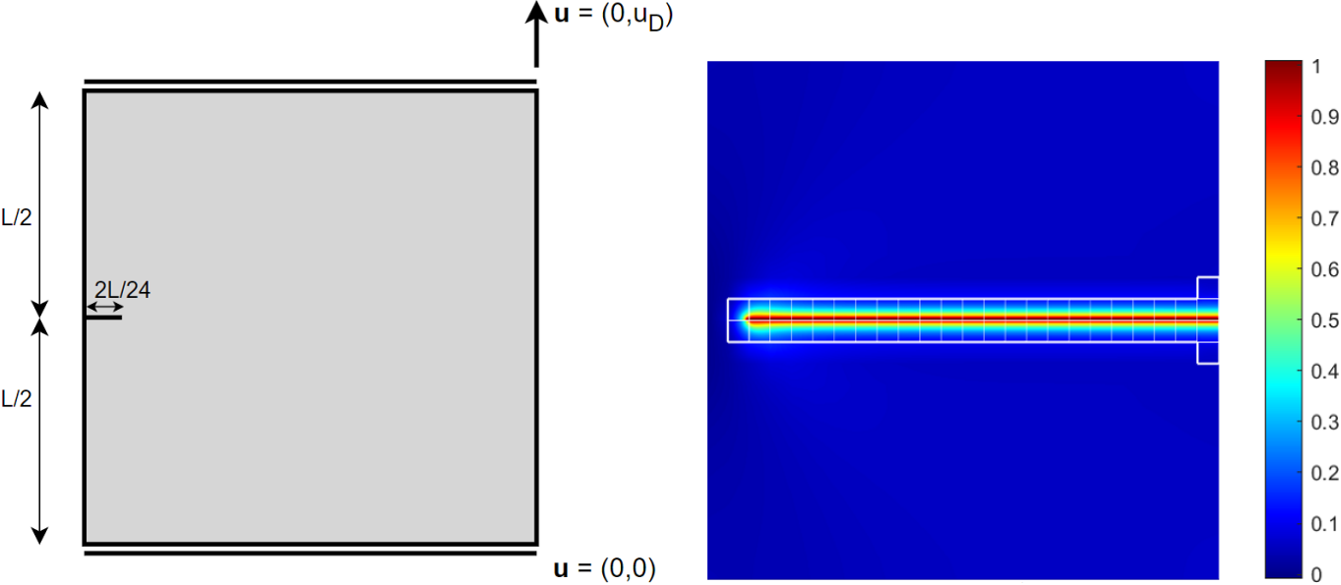
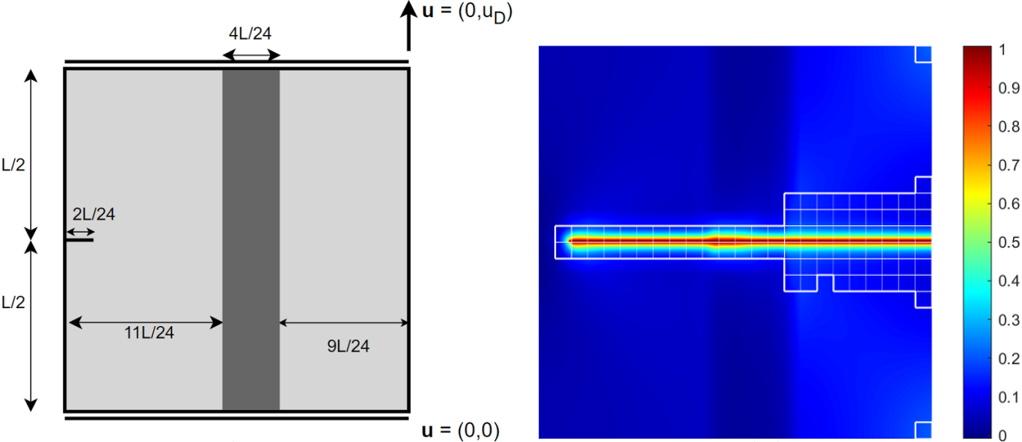
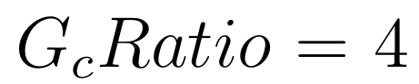

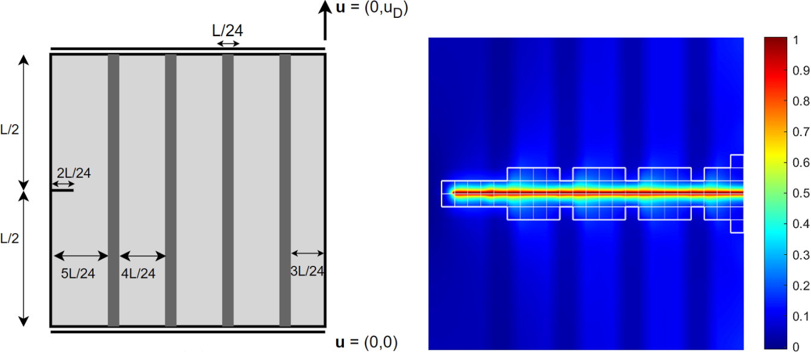
Improving the resistance by placing inclusions

Slide 25
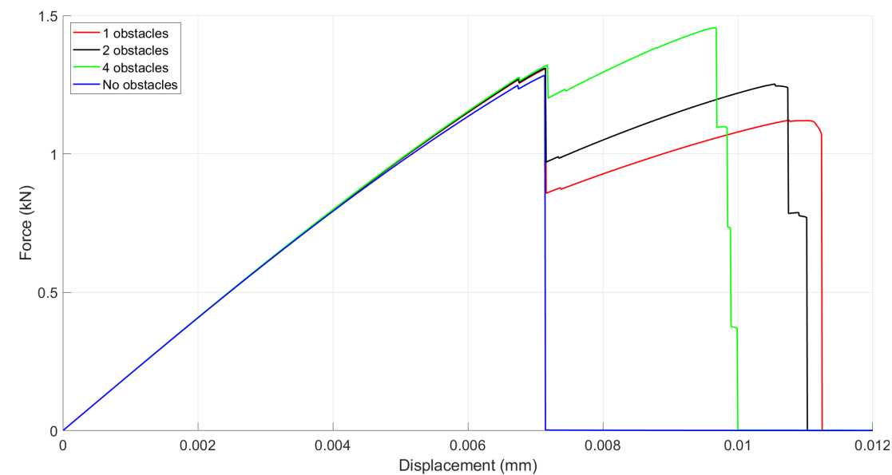
Improving the resistance by placing inclusions

Slide 26
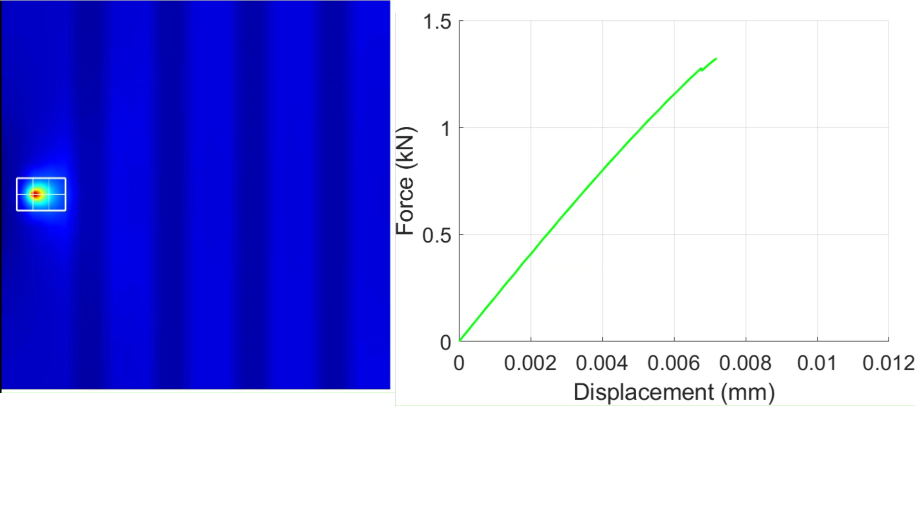
Improving the resistance by placing inclusions

Slide 27
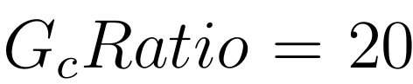
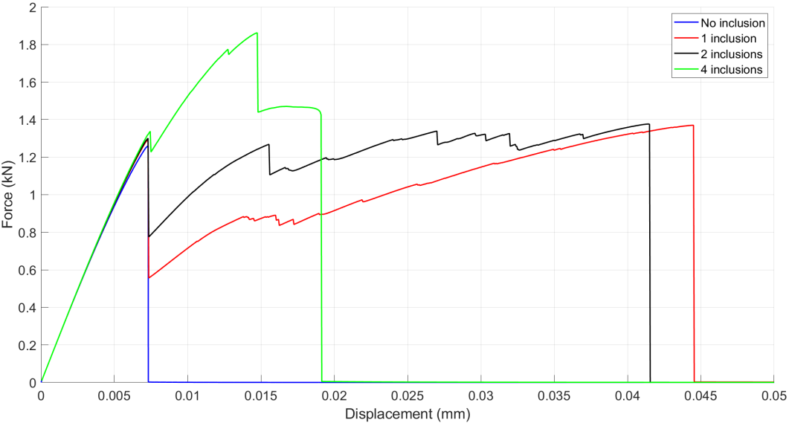
Improving the resistance by placing inclusions

Slide 28
My contributions
Extended the adaptive hybrid phase-field model implementation for homogeneous materials, Muixí (2020), to heterogeneous materials
Developed a robust algorithm for visualizing different sorts of deformed meshes during runtime
Design, execution and analysis of experiments using a variety of tools (Matlab, ez4u, LaCàN computer cluster, NotePad++ and Excel)

Slide 29
Conclusions
Qualitative analysis of fracture’s behavior when encountering heterogeneity: crack arrest, deflection, penetration and nucleation
Increasing the GcRatio does not always result in a higher peak force & total displacement
Obtaining the maximum peak force or total displacement by distributing a constant area into different inclusions
Fracture can be narrowly guided by offering paths of less resistance

Slide 30
Outlook
Probabilistic inclusions
Extension to three-dimensions
Experimental validation – Design of multi-layered materials

Slide 31
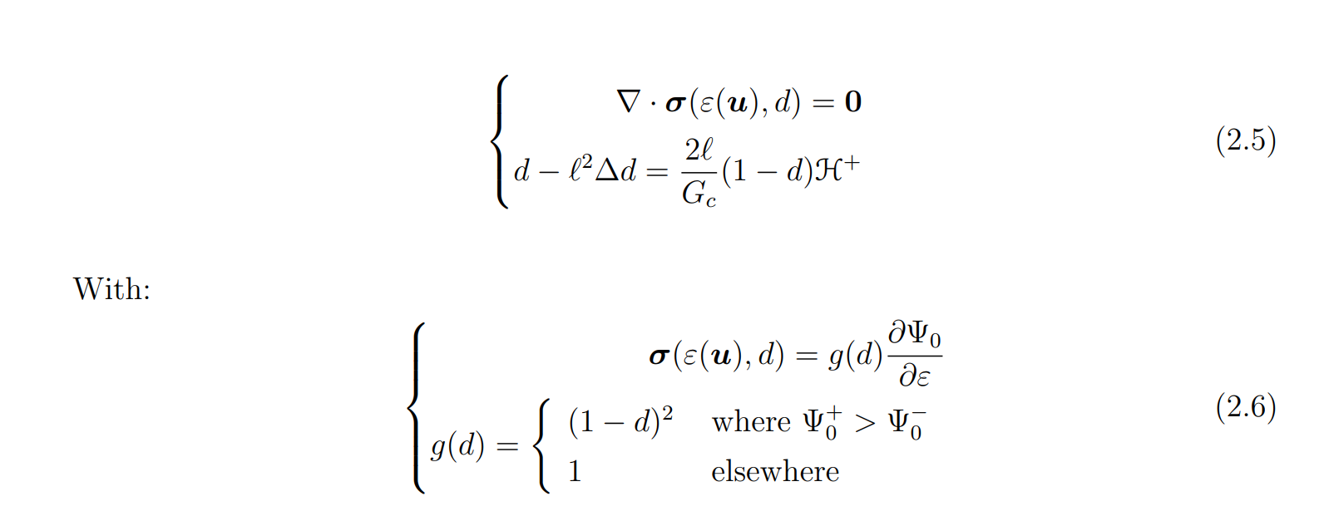
Adaptive hybrid phase-field model
Ambati et al. (2015)

Slide 32




Validation
Statement;
Ambati et al. (2015)
Experiment with cement mortar – Area marking the observed crack patterns; Ambati et al. (2015)
Hybrid phase-field model; Ambati et al. (2015)
Adaptive hybrid phase-field model; Muixí (2020)

Slide 33

Computational fracture mechanics
Continuous displacement field
Deformation scale factor = 10

Slide 34


Adaptive refinement

Slide 35

Adaptive refinement
Deformation scale factor = 10

Slide 36


Material parameters and heterogeneity
Young modulus E = 210 GPa
Poisson’s ratio ν = 0
Fracture toughness

Slide 37
Arrest, deflection and penetration of the crack
Tension test

Slide 38

Improving the resistance by placing inclusions
Crack nucleation
Breaks symmetry

Slide 39




Improving the resistance by placing inclusions

